Slide 1


MONSTER’S RECOVERY
Caleb Dease, Bladon Mayes, David Milbern, Deepshikha Purwar
Notes:
Bladon

Slide 2
FOUNDING BACKGROUND
The Monster Board was launched in January 1994 by Jeff Taylor
First online job seeker board
Monster.com was branded in 1999
Revolutionized job postings, candidate application process and disrupted the classified print ad business for jobs.
At its peak, Monster was valued at more than $8 billion.
In 2016, Monster was purchased for $429 million, about 5% of Monster’s peak value
Notes:
Caleb

Slide 3
SO, WHAT HAPPENED?
Decline from #1 job board in the world facilitated by:
Poor CEO decision making:
Loss of founding purpose
Increased focused on stock price and profits
A lack of innovation and failure to adapt
Today:
Monster is the 488th most trafficked website in the US
Becoming Increasingly irrelevant compared to sites like Indeed.com or LinkedIn
Notes:
Caleb
Reference 1: https://www.forbes.com/sites/lisaearlemcleod/2014/11/05/why-monster-is-failing-and-others-will-follow/#6933040047db
Relied on old business model -- Resource specialization lock-in trap
Reference 2:
https://www.alexa.com/siteinfo/monster.com

Slide 4
MONSTER’S RECOVERY OBJECTIVES
Improve the Monster.com Products and Recapture Market Share
Analysis of the Job Posting Data
Utilize Modeling Techniques to Promote Business Intelligence
Help Monster.com relate better to both customer bases
Notes:
Caleb

Slide 5
CLEANING THE DATA
JOB_TITLE | LOCATION | CITY | STATE | ZONE | JOB_TYPE | SALARY | SECTOR | WORD_COUNT | YEARS_OF_EXPERIENCE | ORGANIZATION | JOB_DESCRIPTION | PAGE_URL
it support technician | MADISON,WI | MADISON | WI | MIDWEST | Full Time Employee |  | IT/Software Development | 444 | 6 |  | TeamSoft is seeing an IT Support Specialist to join our client in Madison, WI. The ideal candidate must have at least 6 years of experience in the field. They need to be familiar with a variety of the field's concepts, practices, and procedures as this position relies on extensive experience and judgment to plan and accomplish goals. Required Skills:‰Û¢ Call tracking software‰Û¢ Phone based technical support‰Û¢ Problem documentation and communication‰Û¢ Remote Desktop Management Tools‰Û¢ Respond to customer requests‰Û¢ General understanding of LANDesk‰Û¢ Microsoft Office 2007 SuiteFind out why TeamSoft is the Madison area's technology leader with over 200 IT consultants. Owned, operated, and managed by IT consultants, TeamSoft is the clear choice for your career. Join the | http://jobview.monster.com/it-support-technician-job-madison-wi-us-167855963.aspx?mescoid=1500134001001&jobPosition=20
Notes:
Bladon

Slide 6
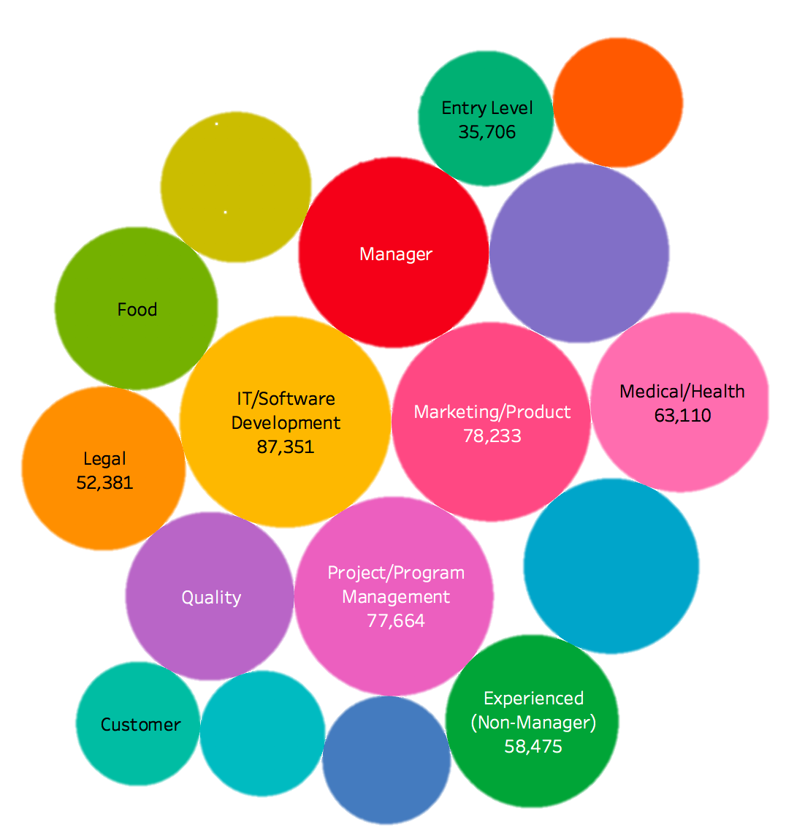
INITIAL PRACTICAL ANALYSIS
Sector | Key Words (stemmed)
IT/Software Development | experi, manag, develop, requir, busi, project, skill, system
Marketing/Product | market, sale, manag, ar, custom, level, client, team, servic
Project/Program Management | store, manag, assist, custom, associa, thi, posit, task, servic
Manager (Manager/Supervisor of Staff) | manag, experi, ar, requir, servic, qualiti, develop, product
Sales/Retail/Business Development | sale, custom, product, manag, servic, market, ar, experi
Notes:
David

Slide 7
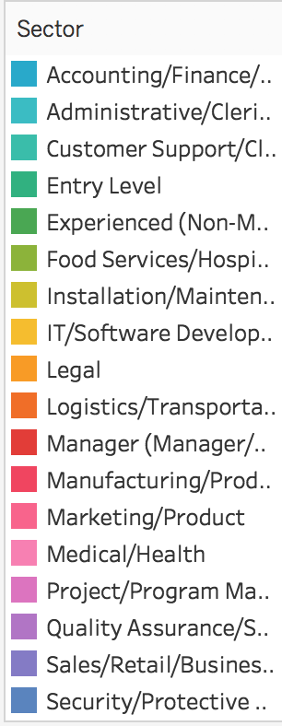
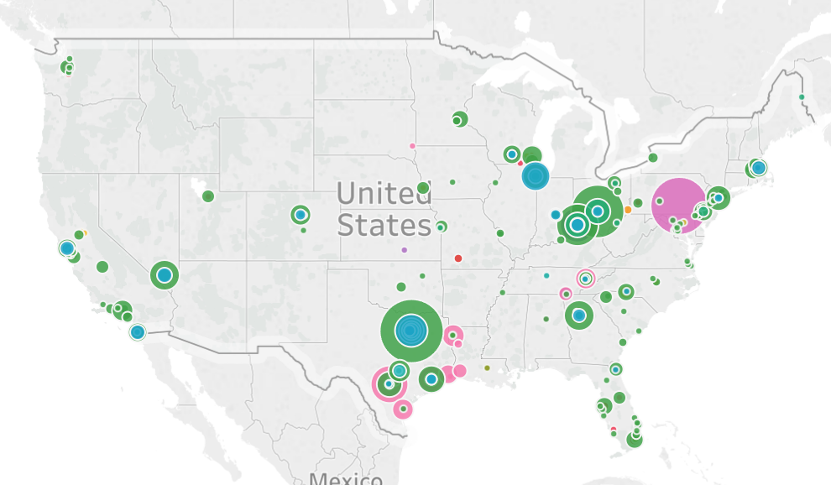
SECTORS AND SALARIES
Notes:
David

Slide 8
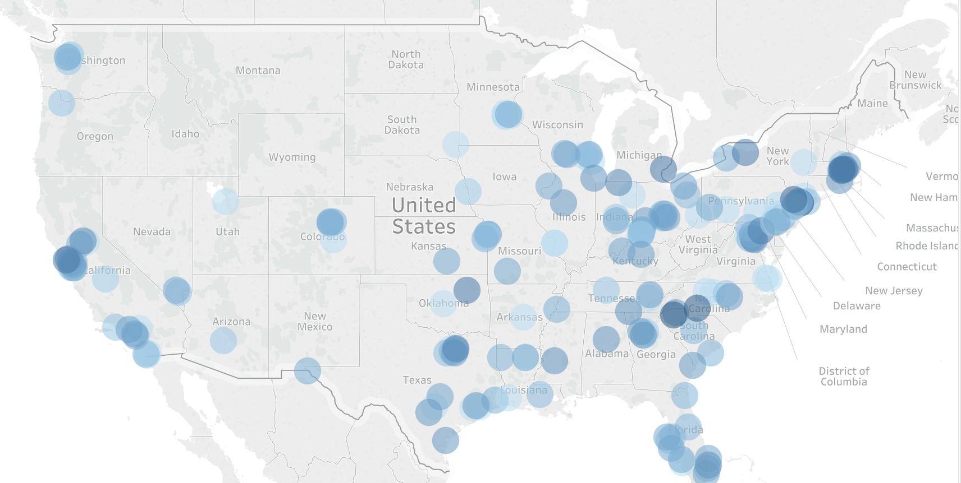
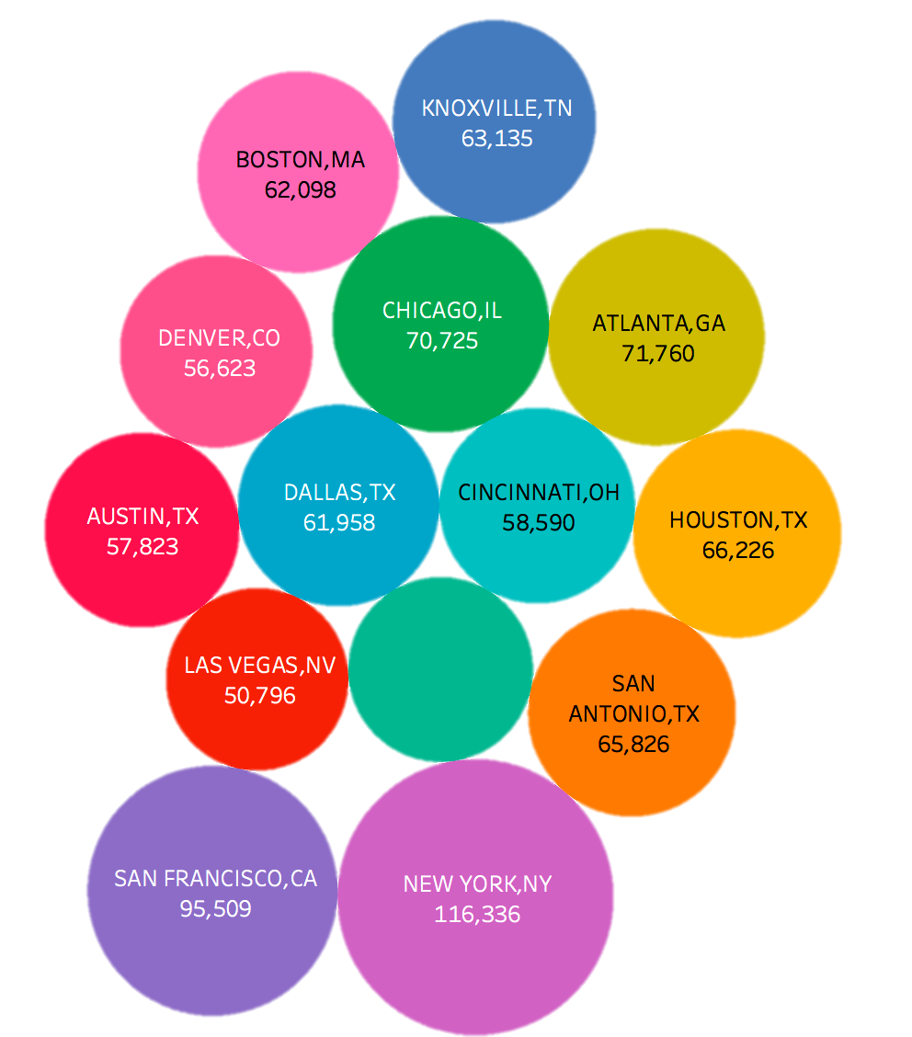
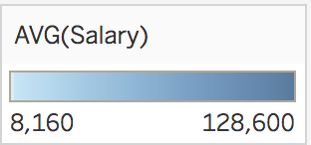
CITIES AND SALARIES
Notes:
David

Slide 9
ANALYSIS METHODS
Text Clustering
Topic Modeling through clustering job descriptions
Sentiment analysis
using a newly created “job satisfaction” dictionary
using polarity and subjectivity
Linear regression to predict salary based on several factors
Notes:
David

Slide 10
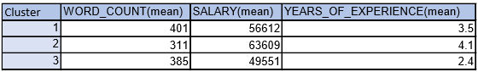
TEXT CLUSTERING
Freq. | Cluster | Key Words | RMSSTD
20% | 1 | service, company, sale, customer, team, opportunity, business, product, market, client marketing, industry, help, grow, join | .112
38% | 2 | experience, year, support, process, skill, project, client, responsibility, opportunity, report, management, responsible, seek, system knowledge | .113
42% | 3 | service, require, assist, benefit, meet, equipment, care, perform, duty, time, state, pay, assign, career, area | .149
note: following terms were removed during parsing of data: look and ee
Notes:
Bladon

Slide 11
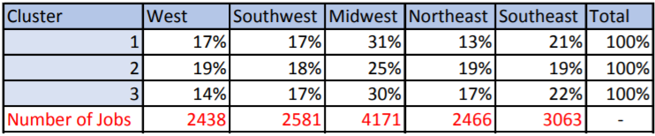
TEXT CLUSTERING
Cluster-Specific US Zone Distribution
Notes:
Bladon

Slide 12
TEXT CLUSTERING
Labels
Insights
Cluster 1 - Longest job descriptions with median salaries and years of experience (20%)
Cluster 2 - Shortest job descriptions with the highest salaries and years of experience (38%)
Cluster 3 - Lowest salaries with least amount of years of experience (42%)
Cluster 1 - terms such as opportunity, business, product, market, and client marketing suggest these jobs are mid-level jobs that are focused on working directly with the product and services.
Cluster 2 - terms such as experience, management responsible, system knowledge, responsibility, and skill suggest these jobs are high-level jobs that are focused on the higher level tasks such as management and skill specialization.
Cluster 3 - terms such as career, perform, duty, time, service, and pay suggest that these are entry-level jobs that are focused on core business and daily running of operations
Notes:
Bladon

Slide 13
TOPIC MODELING ON “ENTRY LEVEL”
BREAKING DOWN EXPERIENCED(NON-MANAGER)
Freq. | Key Words | RMSSTD | Name
6% | People, help, market, level, marketing, customer service, sale, income, relationship, competitive, retail, customer | .143 | Customer Service Rep
16% | cdl, cdl training, bed, truck, driver, class, requisition, truck, pickup,, bulk, bus, class, pay, hand, local, home, transportation | .133 | Driver/ Truck Driver
3% | Safety, food, condition, table, station, label, company policy, dress code, appearance, clear, look, occurrence, cleanliness, dignity, dress | .114 | Food Supervisor/ Inspector
8% | Care, health, medical, patient, case, treatment, span, true, switch, client-social-youtube, clinical, data-track, default, match | .122 | Healthcare
29% | Basic, construction, guard, national, engineer, combat, drill weekend, military enlistment, physical exam, regular paycheck, service-low-cost insurance, citizenship | .123 | National Guard
38% | Ability, customer, communication, include, opportunity, office, knowledge, perform, high, individual,, task, excel, Microsoft, written, business, strong | .110 | Sales Manager
Notes:
Deep

Slide 14
TOPIC MODELING ON “EXPERIENCED(NON MANAGER)”
BREAKING DOWN EXPERIENCED(NON-MANAGER)
Freq. | Key Words | RMSSTD | Name
4% | store, merchandise, help, state, career, cash, serve, control, clean, cashier, deposit, | .127 | Retail Cashier
8% | nurse, care, staff patient, patient, health, medical, state, license | .079 | Registered Nurse
13% | equipment quality, repair, control, tool, standard, maintenance, quality, production | .096 | Quality Control
14% | client, office, seek, report, protect, document veteran, 'veteran status' | .084 | Office Professional
15% | plan, management, business, manager, market, industry, relationship, sale | .101 | Sales Manager
9% | lift physical, merchandise, school, age minimum, stand, diploma | .145 | Field Services Tech
21% | test, design, client, information, development, protect, 'veteran status' | .113 | IT Software
Notes:
Deep

Slide 15
TOPIC MODELING ON “IT/SOFTWARE DEVELOPMENT”
BREAKING DOWN EXPERIENCED(NON-MANAGER)
Freq. | Key Words | RMSSTD | Name
15% | Benefits, consulting, career, day, interview, job, candidate, position, web, opportunity, employee information, employer, plan, industry, company, require | .142 | Generic Job Terms
19% | Network, hardware, windows, troubleshooting, resolve, customer, issue, support, problem, software maintain, technical service | .119 | IT Support
18% | Global, cognizant, workforce, visit, employee, future, build, help, equal, perform, information technology, service, consulting, strong technical | .145 | Consultant
47% | Team, project, design, develop, report, development, test, manage, degree, experience, management, plan, requirement, application, data, business process, ability | .117 | Tech Lead/ Manager
Notes:
Deep

Slide 16

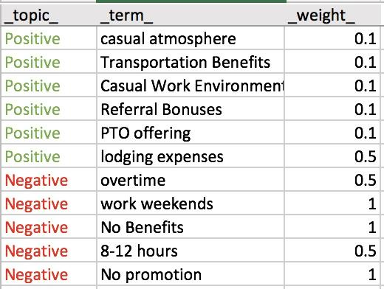
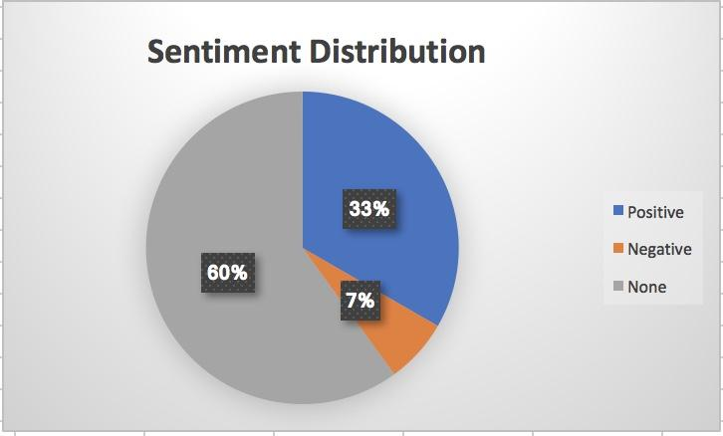
SENTIMENT ANALYSIS USING DICTIONARY
User Created Dictionary
Notes:
Deep

Slide 17
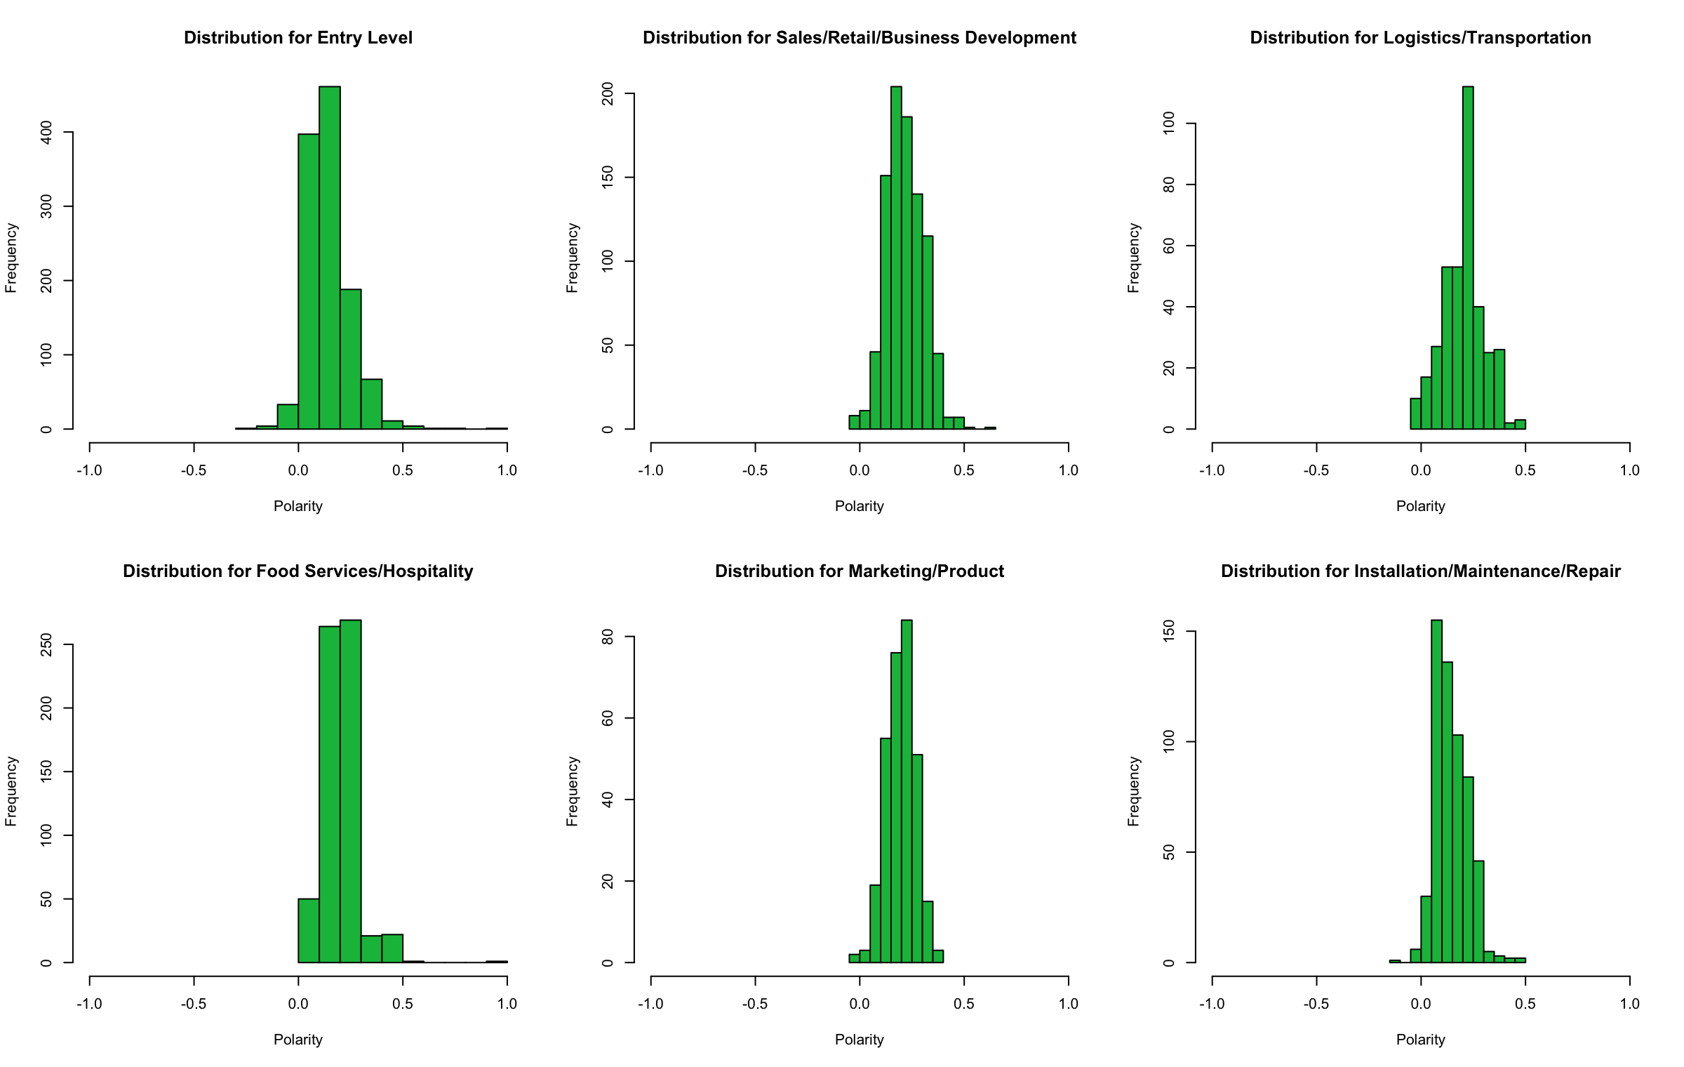
SENTIMENT ANALYSIS
Hypothesis Testing
Focus on Company Culture
Notes:
Deep

Slide 18

SENTIMENT ANALYSIS
Advertising Sales Associate needed (Part-time) in the Wilson area. Flexible hours - Must have dependable transportation - Must be at least 21 years old.Send resume to:WCPD, P.O. Box 3412 Wilson NC 27894
Byers Ford is seeking an entry level Body Shop Estimator. Job Purpose: Estimates automotive body repairs by ascertaining body damage; developing estimates; preparing work orders; contacting insurance company; maintaining customer rapport. Byers is family owned and operated and has been in business since 1897. We offer excellent employee benefits including health, vision, dental insurance and 401k. Please submit resume to Body Shop Manager Dick Hatfield at dhatfield @byersauto.com
Notes:
Deep

Slide 19
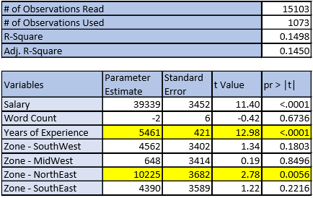
LINEAR REGRESSION
Results
Years of Experience - Highly significant - $5461 increase to salary per year of experience required
NorthEast Zone - Highly significant - $10225 more in salary compared to the West zone
Limitations
Cutoff significance level at 5% - highlighted in yellow
Dummy Variables - the 5 zones
Low number of observations used - 1073 observations (~7.1%)
Low R-Sq and Adj, R-Sq - noisy and unstructured data
Notes:
Bladon

Slide 20
BUSINESS RECOMMENDATION #1
Implement classifier algorithms to analyze job seeker resumes and then suggest jobs for them!
Benefits:
Instant results!
Improved customer experience
Modernized approach
Future Benefits:
Opens more opportunities for analysis
Notes:
David

Slide 21
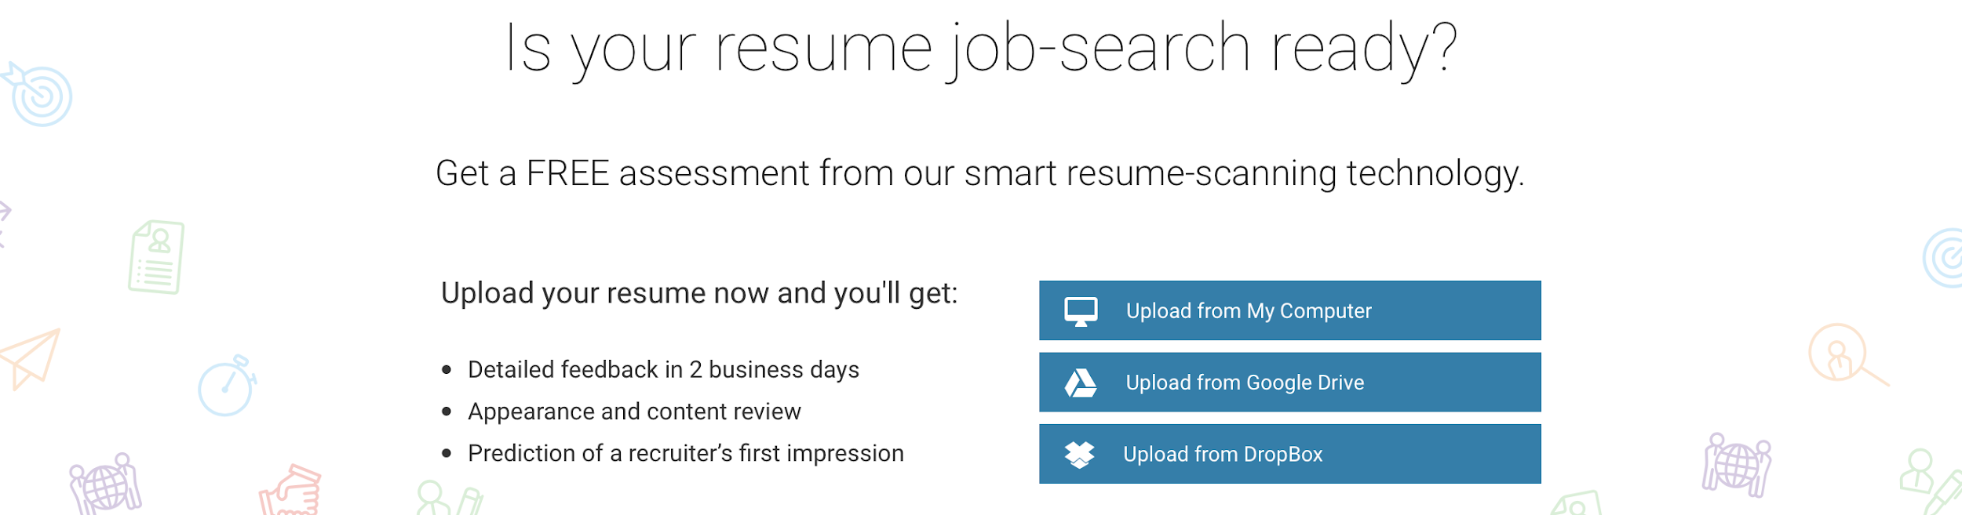

Notes:
David

Slide 22

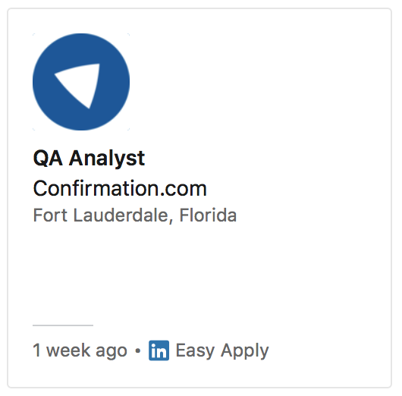
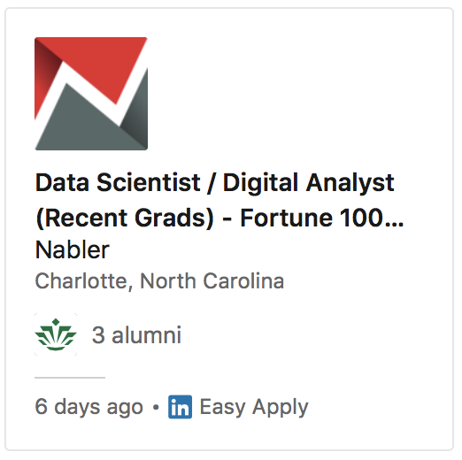
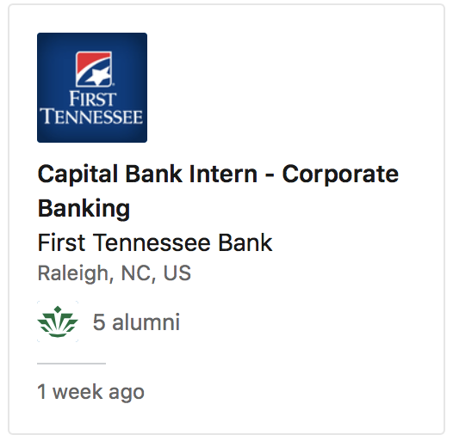
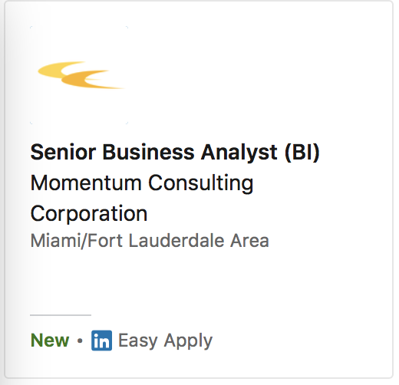
Resume Successfully Uploaded!
Your Descriptive Terms
Recommended Jobs
Notes:
David
How this works:
Using the topic models in our results section, we train a classifier algorithm (like a decision tree), then we apply the model to the new free form resume data.
Jobs that meet a certain criteria are publish.

Slide 23
FUTURE BENEFITS
Implementation of classifier algorithms can lead to conjoint analysis. Used in conjunction with click-stream data, we can find what job qualities are most important to certain users.
Monster can start to build profiles and gain even more insights into the market.
Since monster has a large focus on profits, this can lead to consulting, sales, or more.
Notes:
Caleb

Slide 24
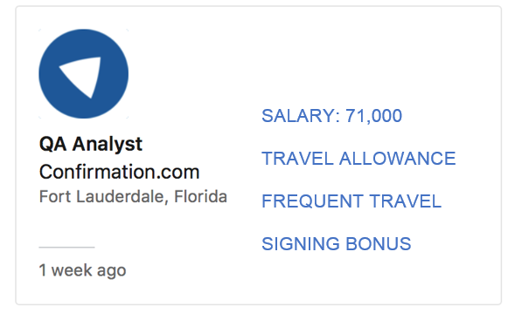
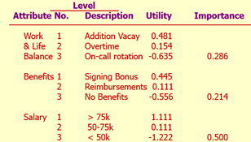
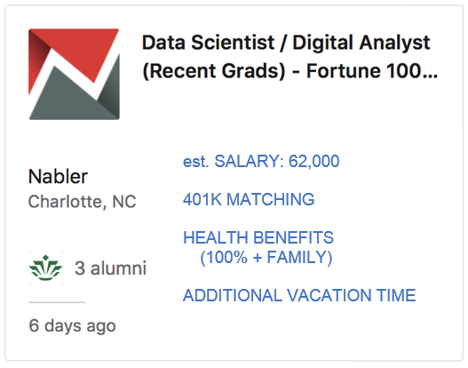
UTILIZING DATA TO OPTIMIZE SENTIMENT DATABASE
Recommended Jobs
Conjoint Analysis
(Attributes sourced from Sentiment Analysis)
Notes:
Caleb
How this works:
Following the clickstream between two jobs, we can start to profile our jobseekers, job posters, and this is not survey data, these are actual clients.

Slide 25
BUSINESS RECOMMENDATION #2
Implement classifier algorithms to analyze job seeker resumes and then suggest jobs for them!
Promote a new brand of credibility by Optimizing the search engine
Benefits:
Data collection
More accurate results
Again, Improved Customer Experience
Notes:
Caleb

Slide 26
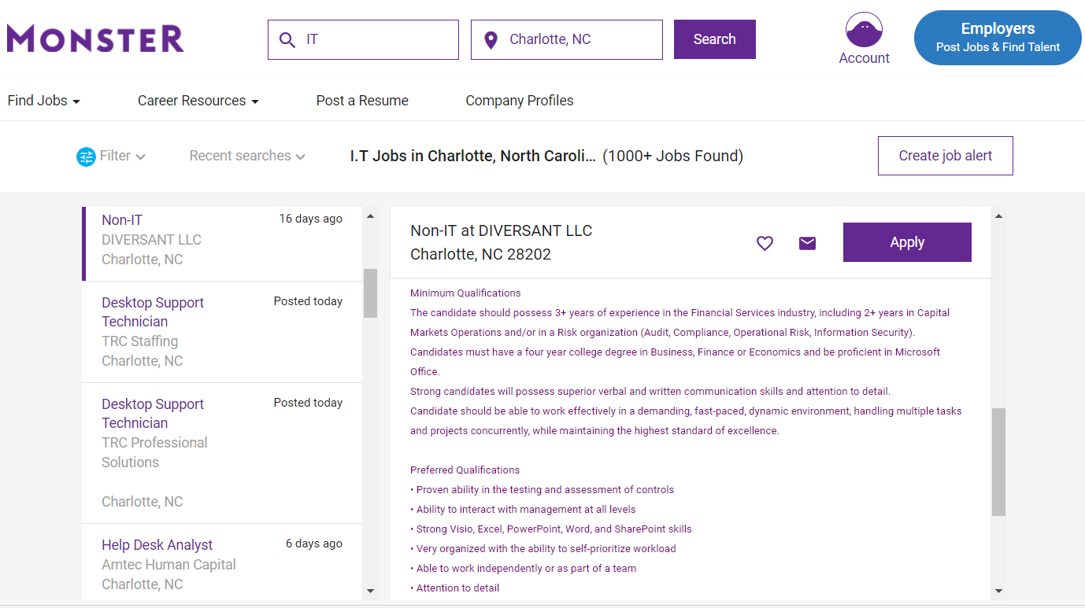
If a job is specifically Non-IT job.
How does it show up?
Notes:
CAleb

Slide 27
VISIO
ASSESSMENT OF CONTROLS
Instead, the job search should include the terms found in the description!
This will add richness to search results
Notes:
CAleb

Slide 28
BUSINESS RECOMMENDATION #3
Implement classifier algorithms to analyze job seeker resumes and then suggest jobs for them!
Promote a new brand of credibility by Optimizing the search engine
Standardize Job Inputs by bringing in public data sources and making use of topic modeling
Benefits:
Predict the emergence of new job fields to help businesses keep up with the changing market
Can improve the speed and ease of use of Monster.com for businesses posting jobs
Notes:
Bladon

Slide 29
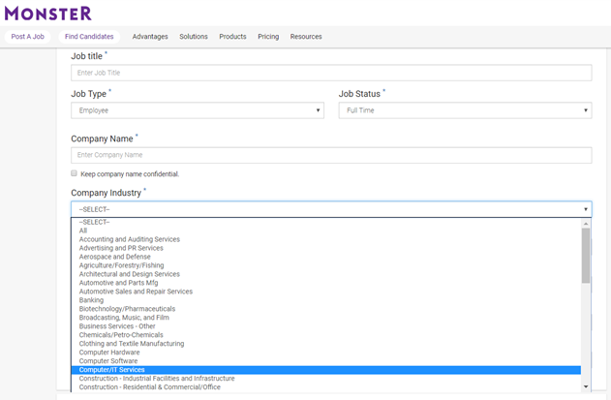
If an employer does not want to select industry..
They can upload their job description, and we can use our topic modeling to suggest industries & job titles..
Notes:
Bladon

Slide 30


Questions?

Slide 31
References
https://www.forbes.com/sites/lisaearlemcleod/2014/11/05/why-monster-is-failing-and-others-will-follow/#6933040047db
https://www.alexa.com/siteinfo/monster.com
https://www.bls.gov/ooh/about/ooh-developer-info.htm
https://www.tableau.com/academic/students
https://www.kaggle.com/PromptCloudHQ/us-jobs-on-monstercom
https://visual.ly/community/infographic/business/history-monstercom-1967-2012
https://www.ere.net/the-rise-and-fall-of-monster/
http://www.businessinsider.com/indeed-2011-5

